Slide 1
CST-235 Computer Programming III
Topic 5 (3 weeks)

Slide 2
Lectures for Topic 5
Lectures:
Integration Technologies:
REST Services using JAX-RS => Week 1
SOAP Services using JAX-WS => Week 2
Message Services using MDB => Week 3
Hands On:
Design and implement a REST Service.
Design and implement a SOAP Service.
Design and implement a Message Service.

Slide 3
Lectures for Topic 5 – Week 1
Lectures:
Topic 5 Project Assignment Requirements.
Integration Technologies:
Introduction to Integration Technologies
REST API’s
Hands On:
Design and implement a REST Service using JAX-RS.

Slide 4
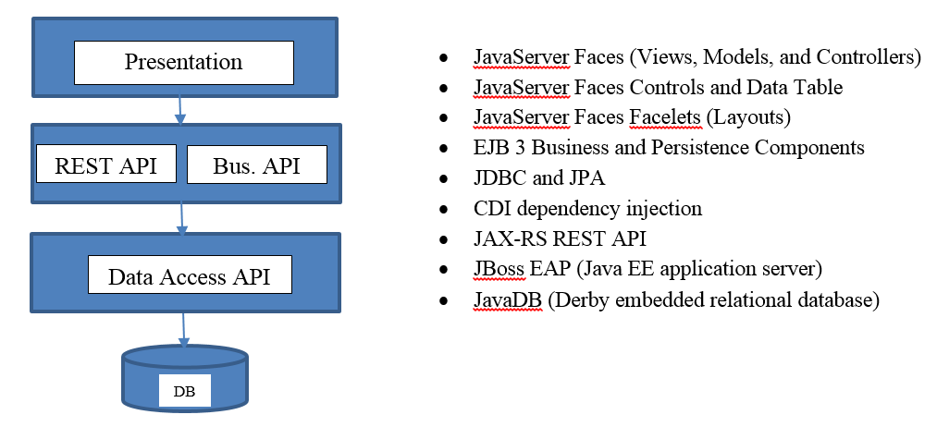
Project Overview
In this class you will design and build a complete enterprise class N-Layer application using Enterprise Java technologies, that meets a certain set of functional and technical requirements, and as shown in the figure below.
The Class Project has changed!

Slide 5
Review Topic 5 Assignment Requirements
Please pull up the Assignment #5 from the Announcement
Review the Requirements
The Class Project has changed. Please pull up the Project Requirements from the Assignment.

Slide 6
Introduction to the Integration Technologies

Slide 7
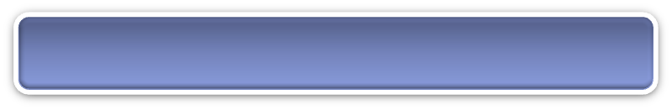
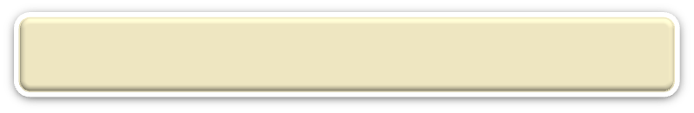
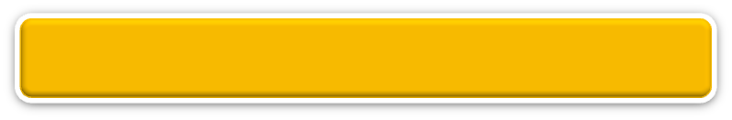
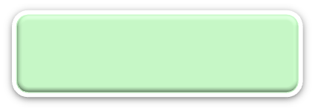


N-Layer Architecture
RIA Design
Client Layer (Desktop/Mobile/Browser)
User Interface, (Minimal) Client Side Validation, AJAX, UI Rules
AJAX
jQuery
CSS
Forms
HTTP/HTTPS POST
Event Based Design
Presentation Layer (PL)
User Interface, UI Event Handlers, UI Rules, Navigation
JSF
Data Validators
Canonical Object Model
Local POJO, SOAP, REST
Design By Contract
Business/Services Layer (BLL)
Business Logic, Business Rules, Workflow, Data Validation
EJB
IoC/CDI
JAX-WS and JAX-RS
JMS
Integration is done by using a number of technologies to expose your Business Services to external systems and applications
Canonical Object Model
Canonical Object Model
Optional SOAP, REST
SOAP, REST
Entity Driven Design
Data Access/Services Layer (DAL)
CRUD Data Persistence
Integration Tier
Orchestration
(Workflow*, Rules*)
Entity Beans (ORM)
Hibernate
JDBC
Data Access Objects
Data Model
JMS, SOAP, REST, JAXB, Spring
Cache
Operational
Database
External Systems
Interfaces, Feeds, Printers
Business Entity
Media

Slide 8
What is Integration?
You application may integrate with other applications or systems to leverage its business services.
You application may expose business services for other applications or systems to leverage your business services.
How applications or systems communicate to access these business services is done by using a number of technologies in Java EE.
Client – Server Programming
Your Application
Another Application or System
API
API
Business Service
Business Service
Integration
by sharing business services!
Java
.NET
Remember, you may be consuming services that are NOT written in Java!

Slide 9
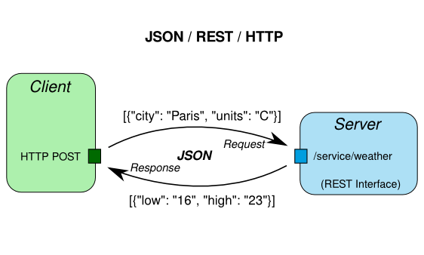

Slide 10
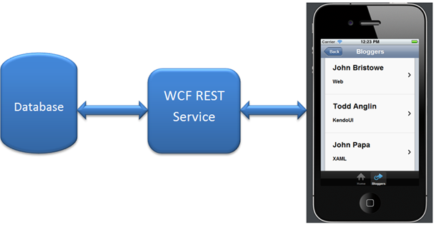

Slide 11
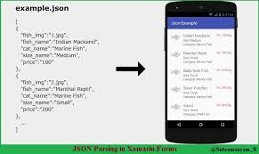

Slide 12
Discussion: Integration Examples
Do you use other applications that can access to Facebook?
Do you use other applications that can access to Twitter?
Do you use other applications that can access Amazon?
What are some other examples where one company or application has provided integration functionality between their business services and other applications?
Google: Facebook API, Twitter API, Amazon API…..and Google API

Slide 13
What technologies are used for Integration?
There are a few technologies built right into the Enterprise Java stack that can be used to integrate your application with other applications or systems.
JAX-RS: REST based services <= has become very popular
JAX-WS: SOAP based services
MDB: Message based services

Slide 14
Introduction to the REST Web Services and JSON

Slide 15
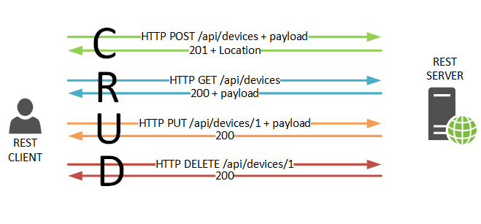
What is the REST protocol?
REST stands for Representational State Transfer
REST relies on a stateless, client-server, communications protocol, that in virtually all cases uses the HTTP(s) protocol.
REST(ful) applications use HTTP(s) requests to post data (create and/or update), read data (make queries), and delete data. REST uses HTTP(s) for all four CRUD operations.
REST is a lightweight alternative to using Remote Procedure Calls and Web Services using the SOAP protocol.
Client – Server Programming
HTTP Protocol (stateless by definition)
Uses HTTP Verbs to read/save/update/delete data
(Mostly) uses JSON as a data payload

Slide 16
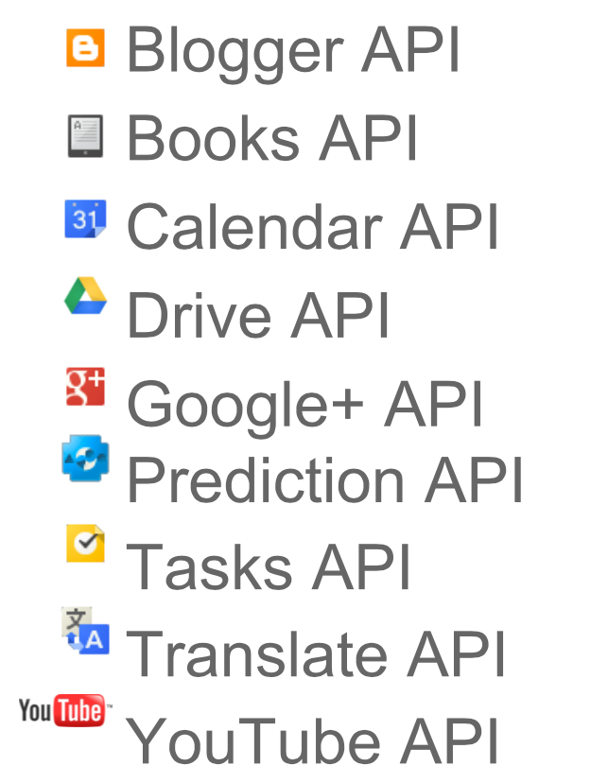
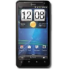
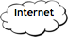
What is a Web API?
Accessing Web Services over the Internet or Intranet via Web Technologies using protocols such as SOAP or REST that exchange Data as either XML or JSON
XML or JSON
Request/Response
SOAP or REST Protocol
Should be Secure!!

Slide 17
What is JSON?
JSON (JavaScript Object Notation) is a lightweight data-interchange format.
It is easy for humans to read and write. It is easy for machines to parse and generate. It is based on a subset of the JavaScript Programming Language.
JSON is a text format that is completely language independent that can be read and processed from programming languages including PHP, C, C++, C#, Java, JavaScript, Perl, Python, and many others.
These properties make JSON an ideal data-interchange language.

Slide 18
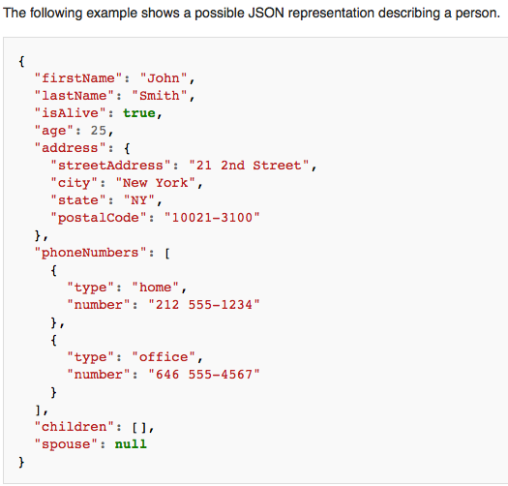
What does JSON look like?
A property is defined as simple name value pairs separated by : and enclosed in “”
An object is defined by {}and can contain nested
properties
Array of objects is enclosed in []

Slide 19
How can I beautify JSON?
When you call a REST based service that returns JSON the JSON is often hard to read (because the service strips all the linefeeds from the response).
To work with JSON so that it is readable you can use a web site such as JSON Pretty Print (at http://jsonprettyprint.com). You simply copy your JSON into the site and click the Pretty Print JSON button.

Slide 20
Can I see an example REST Endpoint?
Go to the following URL:
http://cloudservices-workshop.1d35.starter-us-east-1.openshiftapps.com/cloudservices/rest/weather/test
Hostname of Server where REST Service is running from
App Name
API URI

Slide 21
Can I see an example JAX-RS REST Service?
localhost:8080/assignment5a/rest/weather/test
URI To Service Class and
@Path("weather")
public class RestService
{
@GET @Path("/test")
@Produces("application/json")
public ResponseModel test()
{
// Return a Test Response
ResponseModel response = new ResponseModel(0, "This is a test");
return response;
}
}
Simply a POJO Class
Get Test API at API URI that produces JSON response using HTTP GET
Step 1: Create a POJO with your Service Method.
Step 2: Markup your code using JAX-RS Annotations (import annotations from javax.ws.rs.* package).
Step 3: You will also have to do some one time configuration.

Slide 22
How configure my application to use JAX-RS?
<servlet-mapping>
<servlet-name>Resteasy Servlet</servlet-name>
<url-pattern>/rest/*</url-pattern>
</servlet-mapping>
<context-param>
<param-name>resteasy.scan</param-name>
<param-value>true</param-value>
</context-param>
<context-param>
<param-name>resteasy.servlet.mapping.prefix</param-name>
<param-value>/rest</param-value>
</context-param>
<listener>
<listener-class>
org.jboss.resteasy.plugins.server.servlet.ResteasyBootstrap
</listener-class>
</listener>
<servlet>
<servlet-name>Resteasy Servlet</servlet-name>
<servlet-class>
org.jboss.resteasy.plugins.server.servlet.HttpServletDispatcher
</servlet-class>
</servlet>
REST Easy Servlet URI pattern
REST Easy Servlet Configuration
REST Easy Servlet
You need to configure the REST Easy Servlet in web.xml.

Slide 23
Can I see another REST Service example?
localhost:8080/assignment5a/rest/orders/getjson
URI To Service Class and
Simply a POJO Class
Inject our Orders Business Service
Get JSON API at API URI that produces JSON response using HTTP GET
Get XML API at API URI that produces XML response using HTTP GET

Slide 24
REST API Tools

Slide 25
What Tools Can I use to test REST API’s?
Testing:
Use Postman (go to https://www.getpostman.com)!
You can use this tool during your development to simply test out your API’s (either GET or POST).
You can also use this tool to setup Unit Tests as a Test Suite to test one or more of your API’s.
Documentation:
Use Swagger!
You should always document your API’s in JavaDoc and/or Swagger.

Slide 26
In-Class Activity
Build a REST Service using JAX-RS!
Complete the In-Class Activity #5a that I posted in an Announcement.
Create a JAX-RS compliant REST Service.
Download Postman at https://www.getpostman.com.
Use Postman to test your REST Service

Slide 27
In-Class Activity
Work on Project!
Spend this time to work on the Milestone Assignment.
Design a REST Service API using 2 HTTP Verbs (HTTP GET and HTTP POST).
Return JSON data format.
Document your REST Service API.
What is your API URI?
What JSON do I get in return (document all name value pairs)?
What return error codes do I get in return?
Test your REST Service using Postman.

Slide 28
Weekend Reminders
Work on the design and code for your Milestone Project.
Submit In-Class Activity #5a to the Main Forum.
NOTE: You also need to complete In-Class Activity 5d.
You need to design a REST API with a Christian World View theme.
See the requirements in the In-Class Activity that was posted in an Announcement.

Slide 29
End of Class

Slide 31
Lectures for Topic 5 – Week 2
Lectures:
Integration Technologies:
SOAP API’s
Hands On:
Design and implement a SOAP Service using JAX-WS.

Slide 32
Introduction to the SOAP Web Services and XML

Slide 33
What is the SOAP protocol?
SOAP stands for Simple Object Access Protocol
SOAP is a messaging protocol that allows programs that run on disparate operating systems (such as Windows and Linux) to communicate and invoke functions in other applications using HTTP(s) (Hypertext Transfer Protocol) and XML (Extensible Markup Language).
SOAP is analogous to Remote Procedure Calls (RPC), used in many technologies such as DCOM and CORBA.
REST in many use cases has replaced SOAP in the industry

Slide 34
What is XML?
Extensible Markup Language (XML) is a set of rules for encoding documents in machine-readable form.
XML is a simple text-based language, which was designed to store and transport data in plain text format.
It stands for Extensible Markup Language.
XML is a markup language.
XML is a tag based language like HTML.
XML tags are not predefined like HTML.
You can define your own tags, which is why it is called extensible language.
XML tags are designed to be self-descriptive.
XML is a popular format for sharing data on the internet. Websites that frequently update their content, such as news sites or blogs, often provide an XML feed so that external programs can keep abreast of content changes.

Slide 35
What is an XSD?
XSD (also referred to as an XML Schema Definition), is a recommendation of the World Wide Web Consortium (W3C), that specifies how to formally describe the elements in an Extensible Markup Language (XML) document.
It can be used by programmers to verify each piece of item content in a document.
They can check if it adheres to the description of the element it is placed in. Like all XML schema languages, XSD can be used to express a set of rules to which an XML document must conform in order to be considered "valid" according to that schema.
Go to W3 Schools for a good tutorial on XML Schemas. https://www.w3schools.com/xml/schema_intro.asp

Slide 36
What does XML look like?
XML Document start tag
XML Class tag (case sensitive and must have closing tag)
Name tag with data in between start and end tag
Closing tag has / prefix

Slide 37
What is JAX-WS?
JAX-WRS is a specification for building SOAP based services in Java.
An implementation of the specification is included in all Enterprise Java stacks including JBoss.
Although SOAP messages are complex, the JAX-WS API hides this complexity from the application developer.
On the server side, the developer specifies the web service operations by defining methods in an interface written in the Java programming language.
With JAX-WS, the developer does not generate or parse SOAP messages. It is the JAX-WS runtime system that converts the API calls and responses to and from SOAP messages.
JAX-WS makes building SOAP based services easy by simply using a few annotations in your code.

Slide 38
What is a WSDL?
WSDL specifies an XML format for describing a service as a set of endpoints operating on messages.
WSDL is your Service Contract!
The Service Contract defines ALL of your Service Methods and the data types for all your method arguments and return types.
Most of the time you will design your Service Methods, code your Service Methods, and generate the WSDL using the tooling in your IDE.
Go to W3 Schools for a good tutorial on XML WSDL. https://www.w3schools.com/xml/xml_wsdl.asp

Slide 39
How configure my Services to use JAX-WS?
Your SOAP Services are compiled as a Servlet:
<servlet>
<display-name>OrdersSoapService</display-name>
<servlet-name>OrdersSoapService</servlet-name>
<servlet-class>business.OrdersSoapService</servlet-class>
</servlet>
<servlet-mapping>
<servlet-name>OrdersSoapService</servlet-name>
<url-pattern>/OrdersSoapService</url-pattern>
</servlet-mapping>
Your SOAP Service
Your SOAP Service endpoint URI
You need to configure all your SOAP Services in web.xml.

Slide 40
How do I access my SOAP Endpoint?
SOAP Services are accessed most commonly by making a HTTP GET or HTTP POST request to to address of your Services.
The address of your Service is called an Endpoint.
You can easily make a HTTP GET request by using your Browser.
You can also use some tools such as SOAP UI to make SOAP requests to your Endpoint.
Your Endpoint is defined as follows:
http(s)://[hostname]:[port]/[app name]/[servlet name]
You can tack ?wsdl to your API to get a Web Page Test client.

Slide 41
Can I see an example JAX-WS SOAP Service?
localhost:8080/assignment5b/OrderSoapService?wsdl
POJO as a Web Service
Simply a POJO Class
Inject our Orders Business Service
API method
Another API method
Step 1: Create a POJO with your Service Methods.
Step 2: Markup your code using JAX-RS Annotations (import annotations from javax.jws.* package).
Step 3: Generate your WSDL.
Step 4: You will also have to do some one time configuration.

Slide 42
SOAP API Tools

Slide 43
What Tools Can I use to test SOAP API’s?
Testing:
Use SOAP UI (go to https://www.soapui.org)!
You can use this tool during your development as well as use the SOAP client in JBoss Developer Studio.
Documentation:
Documents can be put in your WSDL.
You should always document your API’s in JavaDoc.

Slide 44
Discussion - Should I use XML or JSON? Discussion – Should I use REST or SOAP Services?
Google Pro/Con XML and JSON:
What are some pro’s to using XML?
What are some con’s to using XML?
What are some pro’s to using JSON?
What are some con’s to using JSON?

Slide 45
Should I use SOAP or REST Services?
SOAP is defined by a W3C industry standard.
JAX-WS is an implementation that supports this standard using HTTP, SOAP, and WSDL.
SOAP API’s are driven by an Interface defined in WSDL.
SOAP many features: Security, Transactions, Sync/Async, etc.
REST is lightweight and simple.
REST consumes far fewer server resources.
REST Services can be secured with secure tokens or HTTP Basic Authentication.
Many companies now use REST Services because it is simpler and lightweight.

Slide 46
In-Class Activity
Build a SOAP Service using JAX-WS!
Complete the In-Class Activity #5b that I posted in an Announcement.
Create a JAX-WS compliant SOAP Service.

Slide 47
In-Class Activity
Work on Project!
Spend this time to work on the Milestone Assignment.
Design a REST Service API using 2 HTTP Verbs (HTTP GET and HTTP POST).
Return JSON data format.
Document your REST Service API.
What is your API URI?
What JSON do I get in return (document all name value pairs)?
What return error codes do I get in return?
Test your REST Service using Postman.

Slide 48
Weekend Reminders
Continue to work on the design and code for your Milestone Project.
Submit In-Class Activity #5b to the Main Forum.
NOTE: You also need to complete In-Class Activity 5d.
You need to design a REST API with a Christian World View theme.
See the requirements in the In-Class Activity that was posted in an Announcement.

Slide 49
Lectures for Topic 5 – Week 3
Lectures:
Integration Technologies:
Messaging (JMS and MDB’s)
Hands On:
Design and implement a Message Service using JMS and MDB’s.

Slide 50
Introduction to the Message Based Services

Slide 51
What is Messaging?
Messaging is a method of communication between software components or applications.
A messaging client can send messages to, and receive messages from, any other client. Each client connects to a messaging agent that provides facilities for creating, sending, receiving, and reading messages.
Messaging enables distributed communication that is loosely coupled.
Integration is therefore achieved by sending asynchronous messages between each other.
Client – Server Programming
Your Application
Another Application or System
API
API
Business Service
Business Service
Integration
by sending messages asynchronously
Java
Java

Slide 52
What is JMS?
The Java Message Service (JMS) API is a Java API that allows applications to create, send, receive, and read messages using reliable, asynchronous, loosely coupled communication.
An implementation of JMS is included in all Enterprise Java stacks including JBoss, which uses ActiveMQ for its implementation.
Message Driven Beans (MDB) are used to easily receive JMS compliant messages.
JMS also contains a number of classes and methods to easily send a JMS compliant message.

Slide 53
What are some JMS Concepts?
A JMS provider is a messaging system that implements the JMS interfaces and provides administrative and control features. JBoss includes a JMS provider.
A JMS client is the programs or components, written in the Java programming language, that produce and consume messages. Any Java EE application component can act as a JMS client.
Messages are the objects that communicate information between JMS clients. Messages are sent to Topics and Queues.
You need to configure the JMS Provider in JBoss standalone.xml.

Slide 54
What is Point to Point Messaging?
Point-to-point (PTP) messaging supports sending a message to a specific queue.
Receiving clients extract messages from the queues established to hold their messages.
Queues retain all messages sent to them until the messages are consumed or expire.
Each message has only one consumer.
The receiver can fetch the message whether or not it was running when the client sent the message.
You need to configure the Queues in JBoss standalone.xml.

Slide 55
What is Publish / Subscribe Messaging?
In a publish/subscribe (pub/sub) product or application, clients address messages to a topic.
Publishers and subscribers can dynamically publish or subscribe to the topic.
The system takes care of distributing the messages to its multiple subscribers.
Each message can have multiple consumers.
A client that subscribes to a topic can consume only messages sent after the client has created a subscription, and the consumer is active in order to consume messages.
You need to configure the Topics in JBoss standalone.xml.

Slide 56
What kind of Messages can I send?
The JMS API defines six different types of messages:

Slide 57
How configure my JMS Provider and Queue?
Configuration is done via the JBoss standalone.xml file:
Add the following extension to the bottom of the extensions list:
<extension module="org.wildfly.extension.messaging-activemq”/>
Add the ActiveMQ JSM Provider:<subsystem xmlns="urn:jboss:domain:messaging-activemq:1.0">***</subsystem>
Add Topics and Queues under the message subsystem:<jms-queue name="Order" entries="java:/jms/queue/Order"/>
You need to configure the ActiveMQ JMS Provider in JBoss standalone.xml!
You need to configure your Topics in Jboss standalone.xml!

Slide 58
Can I see an example Message Receiver?
Queue and Message definition
POJO that implements the Message Listener interface
Inject our Orders Business Service
Message receiver code

Slide 59
Can I see an example Message Sender?
JMS Connection and Queue Resource definitions
Create a JMS Connection and Session
Create a JMS Message Producer to send messages with
Send a Text JMS Message
Send an Object JMS Message
Close the JMS Connection

Slide 60
In-Class Activity
Build a Message Service using JMS and MDB!
Complete the In-Class Activity #5c that I posted in an Announcement.
Create a JMS compliant Message Service using a MDB to receive messages.
Send a JMS compliant Message to the MDB.

Slide 61
In-Class Activity
Work on Project!
Spend this time to work on the Milestone Assignment.
Design a REST Service API using 2 HTTP Verbs (HTTP GET and HTTP POST).
Return JSON data format.
Document your REST Service API.
What is your API URI?
What JSON do I get in return (document all name value pairs)?
What return error codes do I get in return?
Test your REST Service using Postman.

Slide 62
Weekend Reminders
Submit Milestone #5.
Submit In-Class Activity #5c to the Main Forum.
NOTE: You also need to complete In-Class Activity 5d.
You need to design a REST API with a Christian World View theme.
See the requirements in the In-Class Activity that was posted in an Announcement.

